Slide 1
Data Lake, Machine Learning and
Analytics

Slide 2



CONSUMPTIO N
ON PREMISES
CLOUD
ADL Analytics
ADL Analytics
Relational DB
Cleansing
Analysis
Web Portals
On Prem HDFS
Azure Data Factory DMG
Azure DW
ADL Store
Azure Data Factory
Power BI
Active Incoming Data

Slide 3








CONSUMPTIO
N
CLOUD
Event data
Enriching
Event data
HDI Storm
ADL
Store
HDI R
Jupyter Data Science Notebooks
Kafka
Event data

Slide 4




ON PREMISES
CLOUD
CONSUMPTION
Alerts
Web Portals
Event data
Event data
EventHubs
Stream Analytics
Data Lake Store
SQL DB
Power BI
Data Factory
Event data
Data Lake Analytics

Slide 5

Azure Data Lake
Store and analyze data of any kind and size
Develop faster, debug and optimize smarter Interactively explore patterns in your data No learning curve
Managed and supported
Dynamically scales to match your business
priorities
Enterprise-grade security
Built on YARN, designed for the cloud
Analytics
HDInsight
U-SQL
Hive
R Server
YARN
WebHDFS
Store

Slide 6
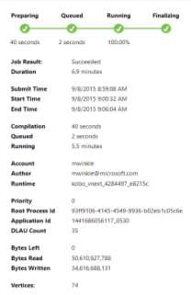
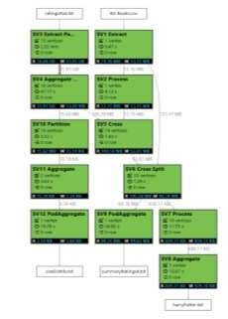
Debug and Optimize your Big Data programs with ease
Deep integration with Visual Studio, Visual Studio Code, Eclipse, & IntelliJ
Easy for novices to write simple queries
Integrated with U-SQL, Hive, Storm, and Spark
Actively offers recommendations to improve performance and reduce cost
Playback visually displays job run

Slide 7
Bringing Big Data to everybody
CONTROL
EASE OF USE
User Adoption
Azure Data Lake Analytics
Specific apps in a multi- tenant form factor
Azure HDInsight
Azure Marketplace HDP | CDH | MapR
Any Hadoop technology
BIG DATA ANALYTICS
Workload optimized, managed clusters
IaaS Hadoop
Managed Hadoop
Big Data as-a-service
Azure Data Lake Store
BIG DATA STORAGE
Azure Storage

Slide 8












Machine Learning Process Model

Slide 9







Azure Machine Learning Studio
ML STUDIO
API

Slide 10
Classification
Regression
Supervised
Agent Based Learning
Unsupervised
Anomaly Detection
Reinforcement Learning
Clustering
https://azure.microsoft.com/en-us/documentation/articles/machine-learning-algorithm-choice

Slide 11
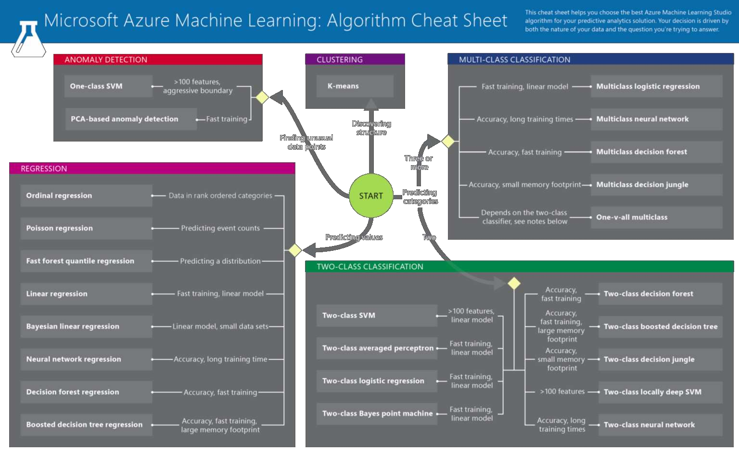
Machine Learning Algorithm Cheat Sheet

Slide 12
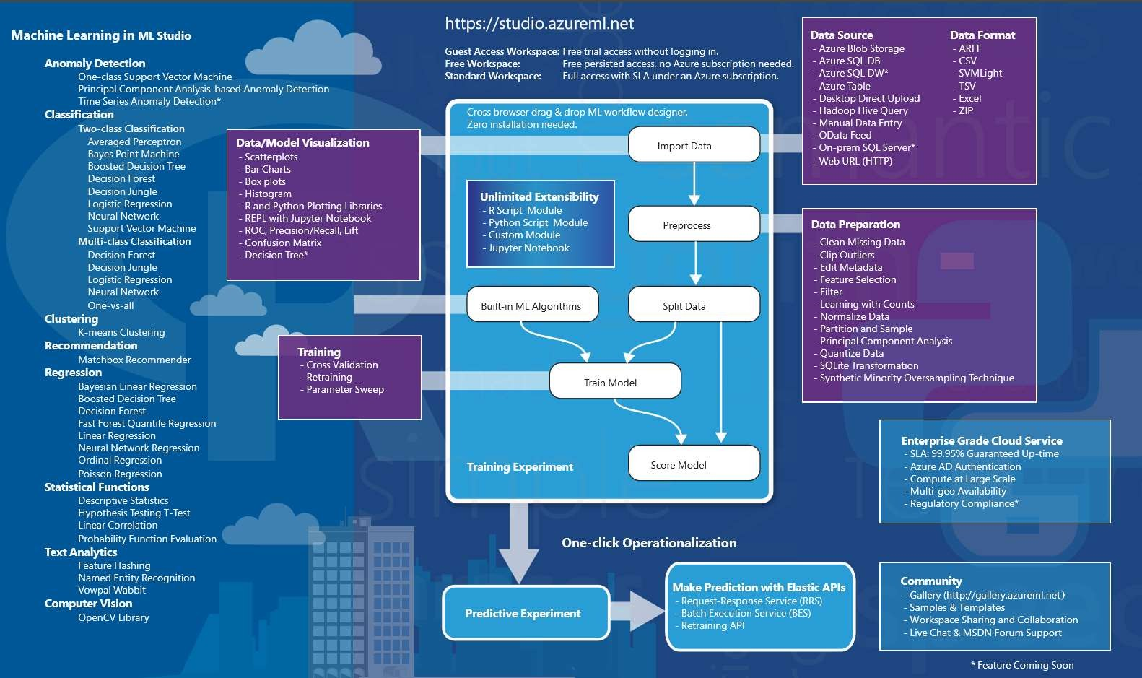

Slide 13
Machine Learning

Slide 14
“A breakthrough in machine learning would be worth ten
Microsofts” - Bill Gates, Chairman, Microsoft
“Machine learning
is the next Internet” - Tony Tether, former director, DARPA
“Machine learning
is the hot new thing” - John Hennessy, President, Stanford
“Web rankings today are mostly a matter of machine learning”
Prabhakar Raghavan, former Dir. Research, Yahoo
“Machine learning is going to result in a real revolution” –
Greg Papadopoulos, former CTO, Sun

Slide 15
What
is
Machine
Learning?
Machine learning is a scientific
discipline that deals
with the
construction and study of algorithms that can learn from
data. Such algorithms operate by building a model based on
inputs and using that to make predictions or decisions, rather
than following only explicitly programmed instructions.
http://en.wikipedia.org/wiki/Machine_learning

Slide 16
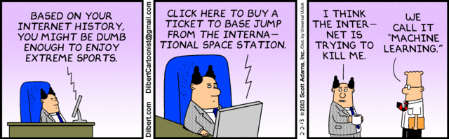
What
is
Machine
Learning?
http://dilbert.com/strips/comic/2013-02-02/

Slide 17

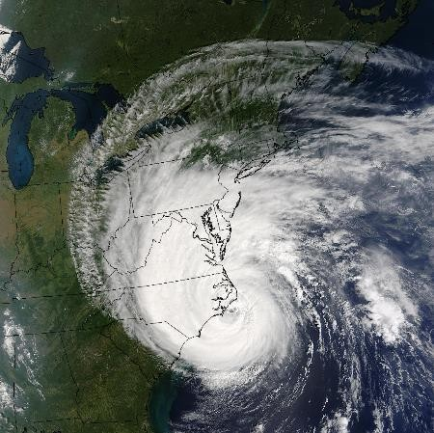



Machine learning – all around us
Weather forecast
Web search and
recomendations
Stock market, temperature value predictions
Face (object) recognition systems

Slide 18
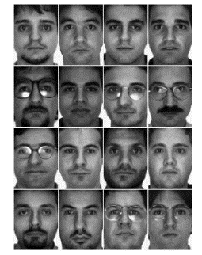



Machine
learning
process

Slide 19
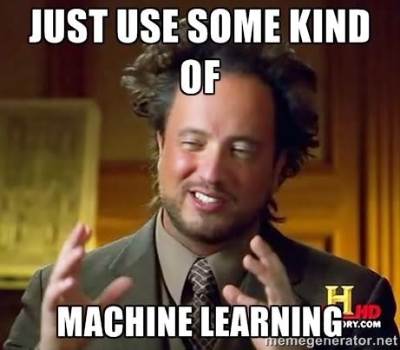
Classes
Classification
of
learning
Binary classification – yes/no, 1/0, male/female
Multi-class classification – {A, B, C, D}, {1, 2}, {teacher, student}
Regression
Predict a real value – temperature, stock value...
Ranking
Order items by some criteria – web search
Clustering
Partition items into group – twitter posts

Slide 20
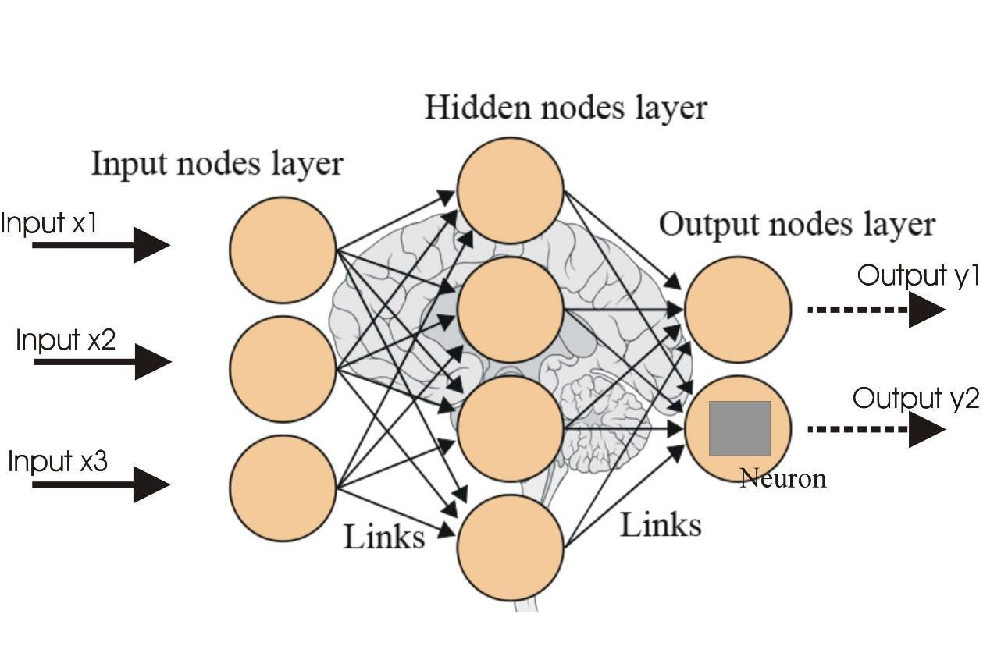
Machine
Learning
algorithms
Neural networks
– supervised learning

Slide 21
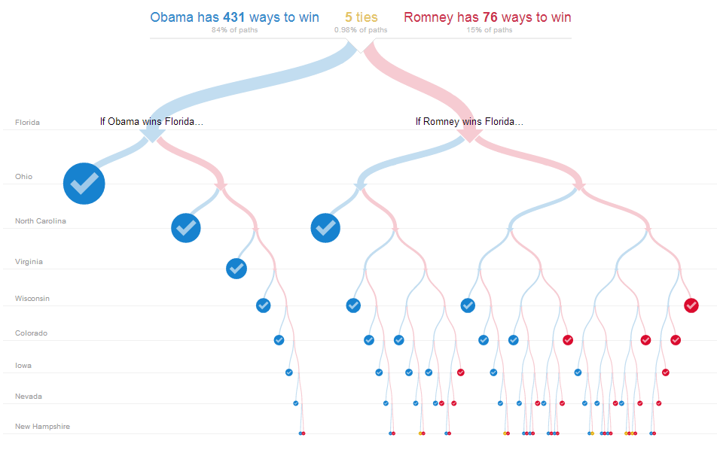
Machine
Learning
algorithms
Decision trees – supervised learning

Slide 22
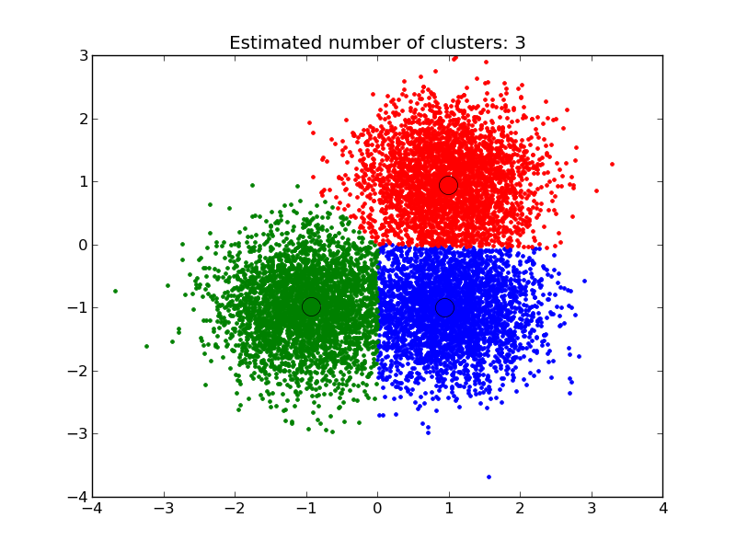
Machine
Learning
algorithms
Clustering – unsupervised learning

Slide 23

Azure
machine
learning

Slide 24
Azure
Machine
Learning
Newest Azure service which reduces complexity of Machine
process and brings ML to broader audience
learning
Possibility to develop and put into production ML models without
writing line of code.
Availability of many top of the class machine learning algorithms
(internally used at other Microsoft products)
Easy ML model deployment and usage using restful API
Easy collaboration on Azure Machine Learning projects
Support for open source framework R

Slide 25
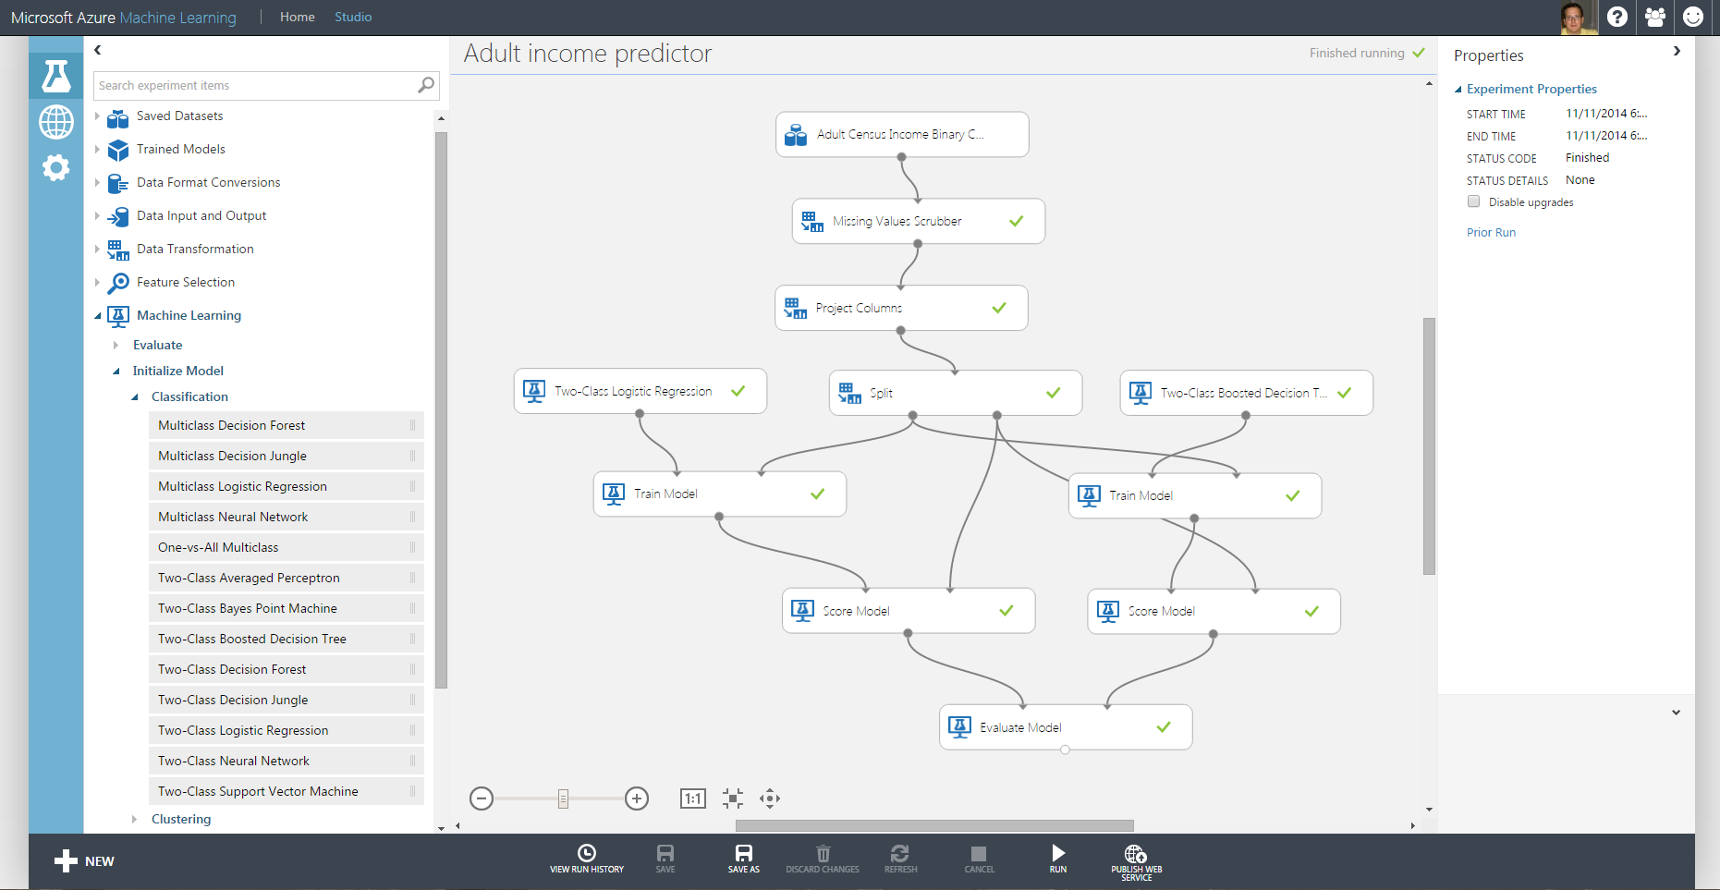
Azure Machine Learning workspace

Slide 26
Azure
ML
workflow
Data
_{Cloud} • HDInsight
• SQL DB
• Blobs & tables
• Local Files
es
Microsoft Azure Machine Learning
Workspace Publish API in minutes
Storage space Web
API
Devices Applications Dashboards
•
SQL Server VM
eet
Local
Business problem
Modeling
Deployment
Business value
http://channel9.msdn.com/events/TechEd/Europe/2014/DBI-B218

Slide 27
DEMO
time!
17

